Slide 1

Monte Carlo Simulation
MTH 564 – Mathematical Modeling

Slide 2

Overview
Monte Carlo simulation is modeling technique that can be used to determine the behavior of stochastic models that are difficult to solve analytically. The often use pseudorandom number generators to mimic random behavior.
Pros
The have wide appeal and can be applied to any probability model.
The are easy to conceptualize and easy to explain.
Often, they are the only viable method for the modeling of many complex stochastic process
Cons
They can be time-consuming.
The repeated sensitivity simulation runs required for accuracy and sensitivity analysis can be expensive.
The probabilistic nature leads to different results for each simulation.

Slide 3
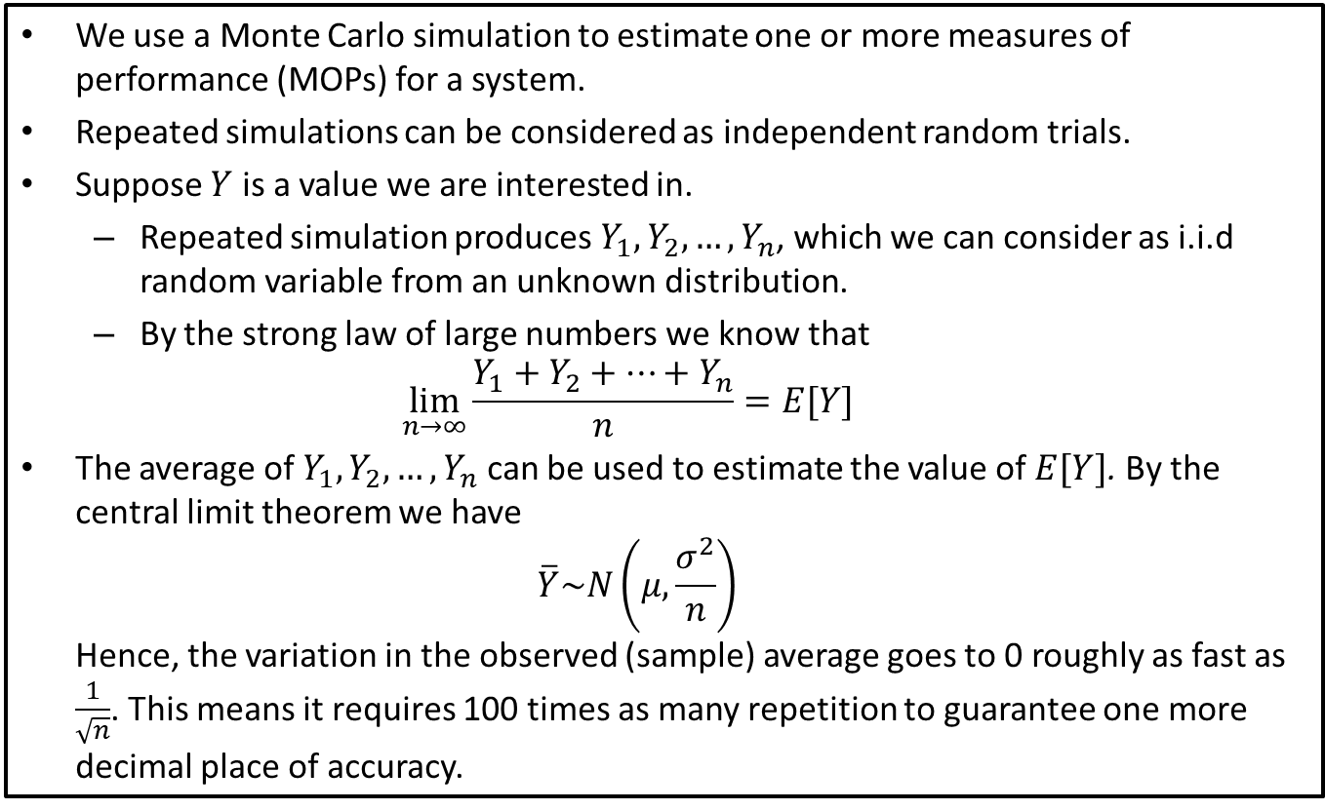
Monte Carlo Simulation
We use a Monte Carlo simulation to estimate one or more measures of performance (MOPs) for a system.
Repeated simulations can be considered as independent random trials.
Suppose $Y$ is a value we are interested in.
Repeated simulation produces $Y_{1}, Y_{2}, …, Y_{n}$, which we can consider as i.i.d random variable from an unknown distribution.
By the strong law of large numbers we know that $\lim_{n→∞}{\frac{Y_{1}+Y_{2}+⋯+Y_{n}}{n}}=E[Y]$
The average of $Y_{1},Y_{2},…, Y_{n}$ can be used to estimate the value of $E[Y]$. By the central limit theorem we have $\overline{Y}\sim N\left(μ,\frac{σ^{2}}{n}\right)$ Hence, the variation in the observed (sample) average goes to 0 roughly as fast as $\frac{1}{\sqrt{n}}$. This means it requires 100 times as many repetition to guarantee one more decimal place of accuracy.

Slide 4
Problem
Arriving on your vacation, you are dismayed to learn that the local weather service forecasts a 50% chance of rain every day this week. What are the chances of 3 consecutive rainy days?

Slide 5
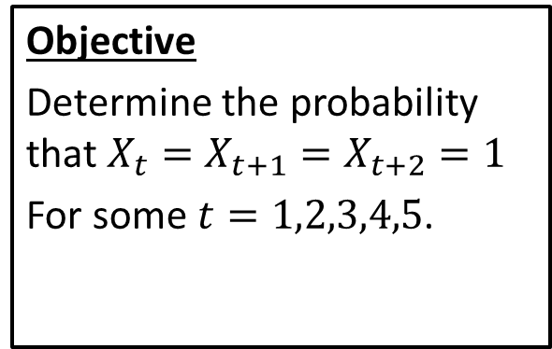
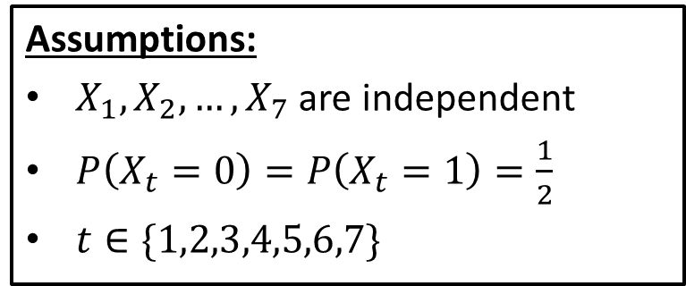
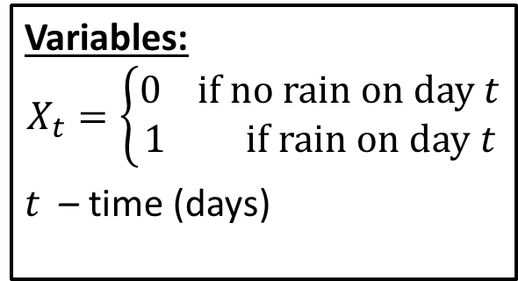
Step 1: Frame the problem
Variables:
$$X_{t}=\left\{\begin{aligned}0 if no rain on day t \\ 1 if rain on day t\end{aligned}\right.$$
$t$ – time (days)
Assumptions:
$X_{1},X_{2},…,X_{7}$ are independent
$P\left(X_{t}=0\right)=P\left(X_{t}=1\right)=\frac{1}{2}$
$t∈\{1,2,3,4,5,6,7\}$
Objective
Determine the probability that $X_{t}=X_{t+1}=X_{t+2}=1$
For some $t=1,2,3,4,5$.

Slide 6
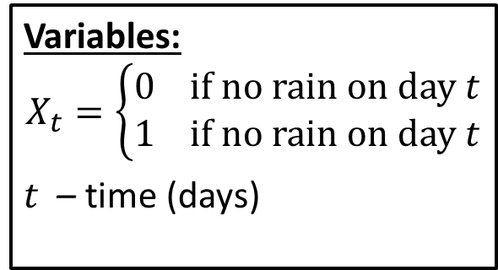
Step 2: Select the modeling approach
Variables:
$$X_{t}=\left\{\begin{aligned}0 if no rain on day t \\ 1 if no rain on day t\end{aligned}\right.$$
$t$ – time (days)
Assumptions:
$X_{1},X_{2},…,X_{7}$ are independent
$P\left(X_{t}=0\right)=P\left(X_{t}=1\right)=\frac{1}{2}$
$t∈\{1,2,3,4,5,6,7\}$
Objective
Determine the probability that $X_{t}=X_{t+1}=X_{t+2}=1$
For some $t=1,2,3,4,5$.
We model this using a Monte Carlo simulation.

Slide 7
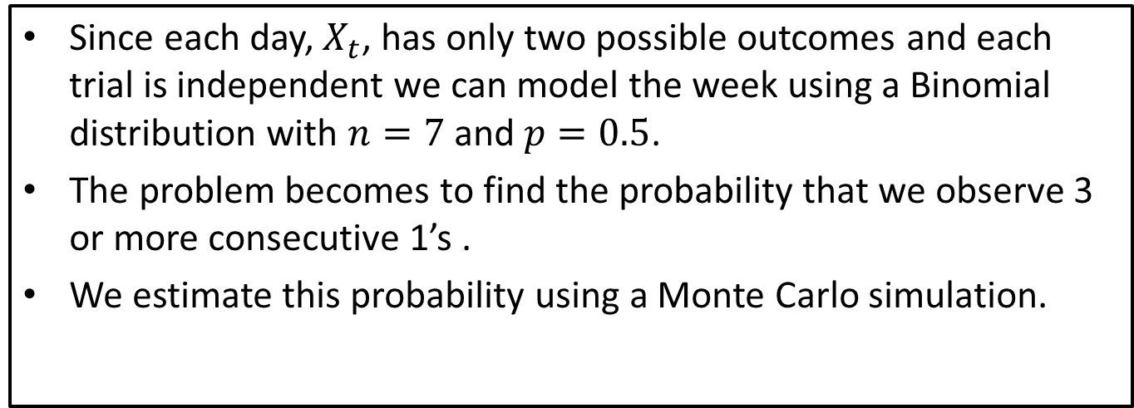
Step 3: Formulate the model
Variables:
$$X_{t}=\left\{\begin{aligned}0 if no rain on day t \\ 1 if rain on day t\end{aligned}\right.$$
$t$ – time (days)
Assumptions:
$X_{1},X_{2},…,X_{7}$ are independent
$P\left(X_{t}=0\right)=P\left(X_{t}=1\right)=\frac{1}{2}$
$t∈\{1,2,3,4,5,6,7\}$
Since each day, $X_{t}$, has only two possible outcomes and each trial is independent we can model the week using a Binomial distribution with $n=7$ and $p=0.5$.
The problem becomes to find the probability that we observe 3 or more consecutive 1’s .
We estimate this probability using a Monte Carlo simulation.

Slide 8
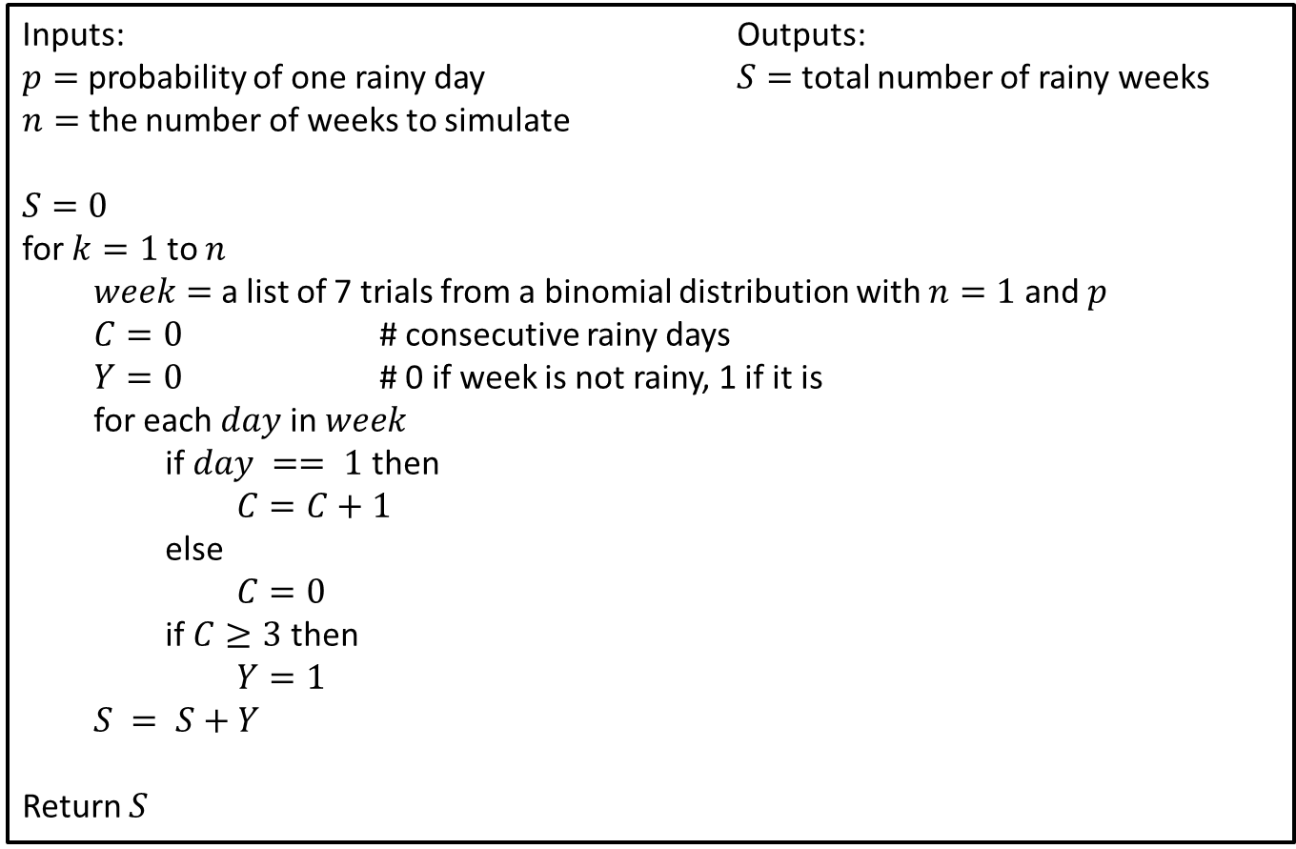
Step 4: Solve the Problem (Pseudo-Code)
Inputs: Outputs: $p=$ probability of one rainy day $S=$ total number of rainy weeks $n=$ the number of weeks to simulate
$S=0$
for $k=1$ to $n$
$week=$ a list of 7 trials from a binomial distribution with $n=1$ and $p$
$C=0$ # consecutive rainy days
$Y=0$ # 0 if week is not rainy, 1 if it is
for each $day$ in $week$
if $day == 1$ then
$C=C+1$
else
$C=0$
if $C≥3$ then
$Y=1$
$S = S+Y$
Return $S$
Notes:
See python file section1-1pig.py

Slide 9
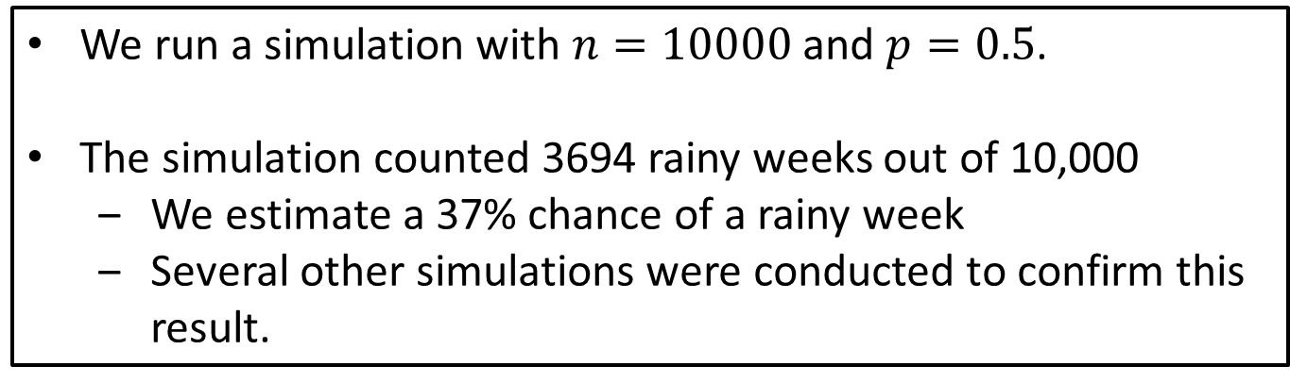
Step 4: Solve the Problem
We run a simulation with $n=10000$ and $p=0.5$.
The simulation counted 3694 rainy weeks out of 10,000
We estimate a 37% chance of a rainy week
Several other simulations were conducted to confirm this result.
Notes:
See python file section1-1pig.py

Slide 10
Step 5: Answer the question
The original problem specified that arriving on your vacation, you find that the local weather service predicts a 50% chance of rain every day for week.
A simulation indicates that, if this forecast is correct, there is a 40% chance that there will be at least 3 consecutive rainy days this week.
There results apply to sunshine as well, and so, there is also at 50% chance of sunshine every day this week, and a 40% chance of at least 3 consecutive days of sunshine.
Notes:
See python file section1-1pig.py

Slide 11
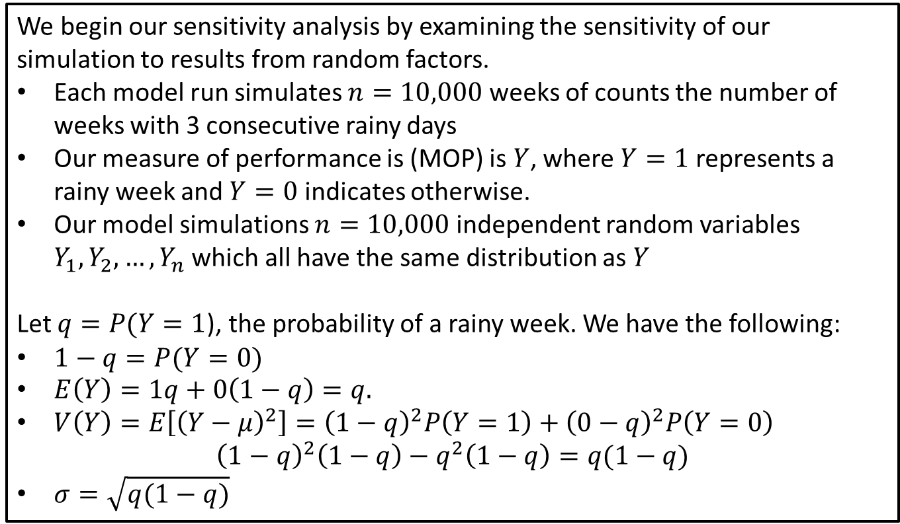
Sensitivity and Robustness Considerations
We begin our sensitivity analysis by examining the sensitivity of our simulation to results from random factors.
Each model run simulates $n=10,000$ weeks of counts the number of weeks with 3 consecutive rainy days
Our measure of performance is (MOP) is $Y$, where $Y=1$ represents a rainy week and $Y=0$ indicates otherwise.
Our model simulations $n=10,000$ independent random variables $Y_{1},Y_{2},…,Y_{n}$ which all have the same distribution as $Y$
Let $q=P(Y=1$), the probability of a rainy week. We have the following:
$1−q=P(Y=0)$
$E\left(Y\right)=1q+0\left(1−q\right)=q.$
$V\left(Y\right)=E\left[{\left(Y−μ\right)}^{2}\right]={\left(1−q\right)}^{2}P\left(Y=1\right)+{\left(0−q\right)}^{2}P\left(Y=0\right)$ ${\left(1−q\right)}^{2}\left(1−q\right)−q^{2}\left(1−q\right)=q(1−q)$
$σ=\sqrt{q(1−q)}$
Notes:
See python file section1-1pig.py

Slide 12
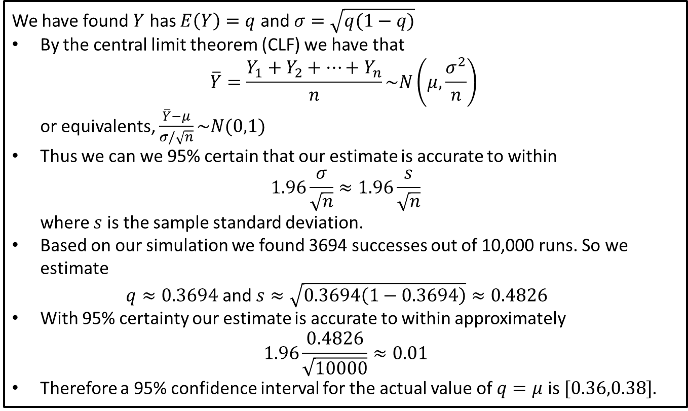
Sensitivity and Robustness Considerations
We have found $Y$ has $E\left(Y\right)=q$ and $σ=\sqrt{q(1−q)}$
By the central limit theorem (CLF) we have that $\overline{Y}=\frac{Y_{1}+Y_{2}+⋯+Y_{n}}{n}\sim N\left(μ,\frac{σ^{2}}{n}\right)$ or equivalents, $\frac{\overline{Y}−μ}{σ/\sqrt{n}}\sim N(0,1)$
Thus we can we 95% certain that our estimate is accurate to within $1.96\frac{σ}{\sqrt{n}}≈1.96\frac{s}{\sqrt{n}}$ where $s$ is the sample standard deviation.
Based on our simulation we found 3694 successes out of 10,000 runs. So we estimate $q≈0.3694$ and $s≈\sqrt{0.3694\left(1−0.3694\right)}≈0.4826$
With 95% certainty our estimate is accurate to within approximately $1.96\frac{0.4826}{\sqrt{10000}}≈0.01$
Therefore a 95% confidence interval for the actual value of $q=μ$ is $[0.36,0.38]$.
Notes:
See python file section1-1pig.py

Slide 13
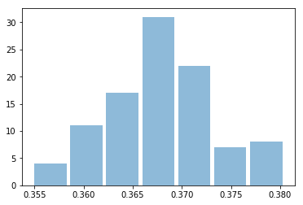
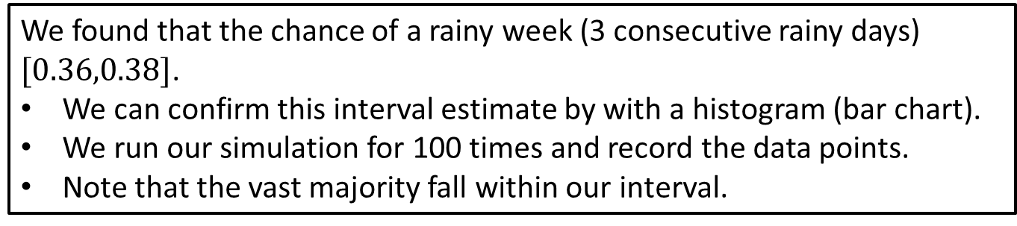
Sensitivity and Robustness Considerations
We found that the chance of a rainy week (3 consecutive rainy days) $[0.36,0.38]$.
We can confirm this interval estimate by with a histogram (bar chart).
We run our simulation for 100 times and record the data points.
Note that the vast majority fall within our interval.
Notes:
See python file section1-1pig.py

Slide 14
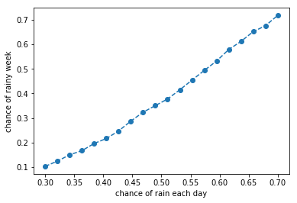
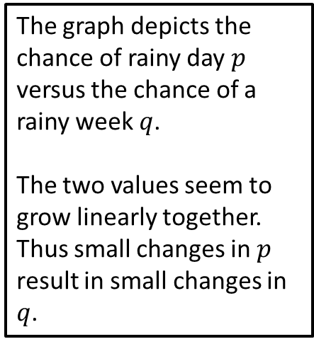
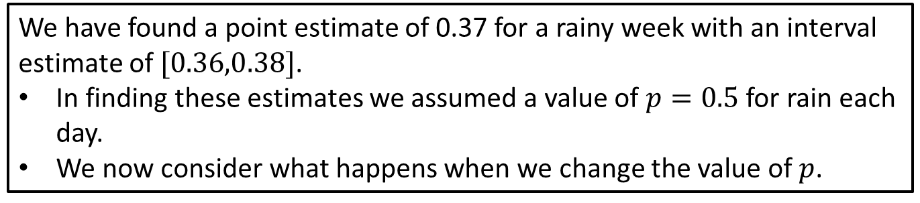
Sensitivity and Robustness: Chance of Rain
We have found a point estimate of 0.37 for a rainy week with an interval estimate of$[0.36,0.38]$.
In finding these estimates we assumed a value of $p=0.5$ for rain each day.
We now consider what happens when we change the value of $p$.
The graph depicts the chance of rainy day $p$ versus the chance of a rainy week $q$.
The two values seem to grow linearly together. Thus small changes in $p$ result in small changes in $q$.
Notes:
See python file section1-1pig.py

